Slide 1

Mambo No. 5: A Little Bit of Kotlin in My Life, A Little Bit of Scala 3 in My Mind
Anthony Accioly

Slide 2
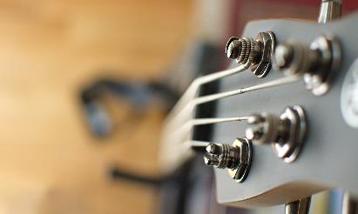



Agenda
Java & Kotlin & Scala 3
Main: Let’s start from the start
Enums
Extension methods
Value classes & Aliases
Kotlin & Scala 3 (Encore)
https://github.com/aaccioly-demos/mambo-no5

Slide 3
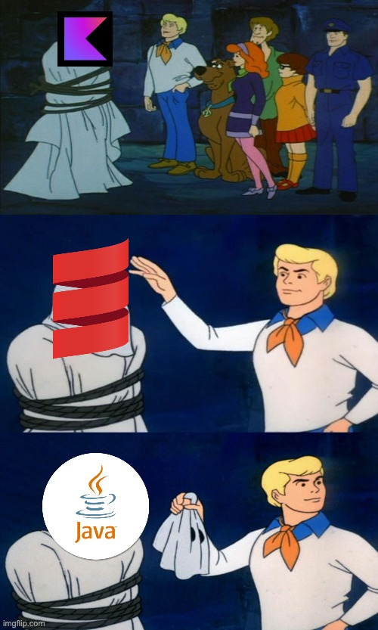
Java & Kotlin & Scala 3
Something about me
Something about you
Something about this talk
Something about the languages

Slide 4

May 23rd, 1995

Slide 5




timeline
1995-1996
2001-2004
2016
2021
2023
3

Slide 6
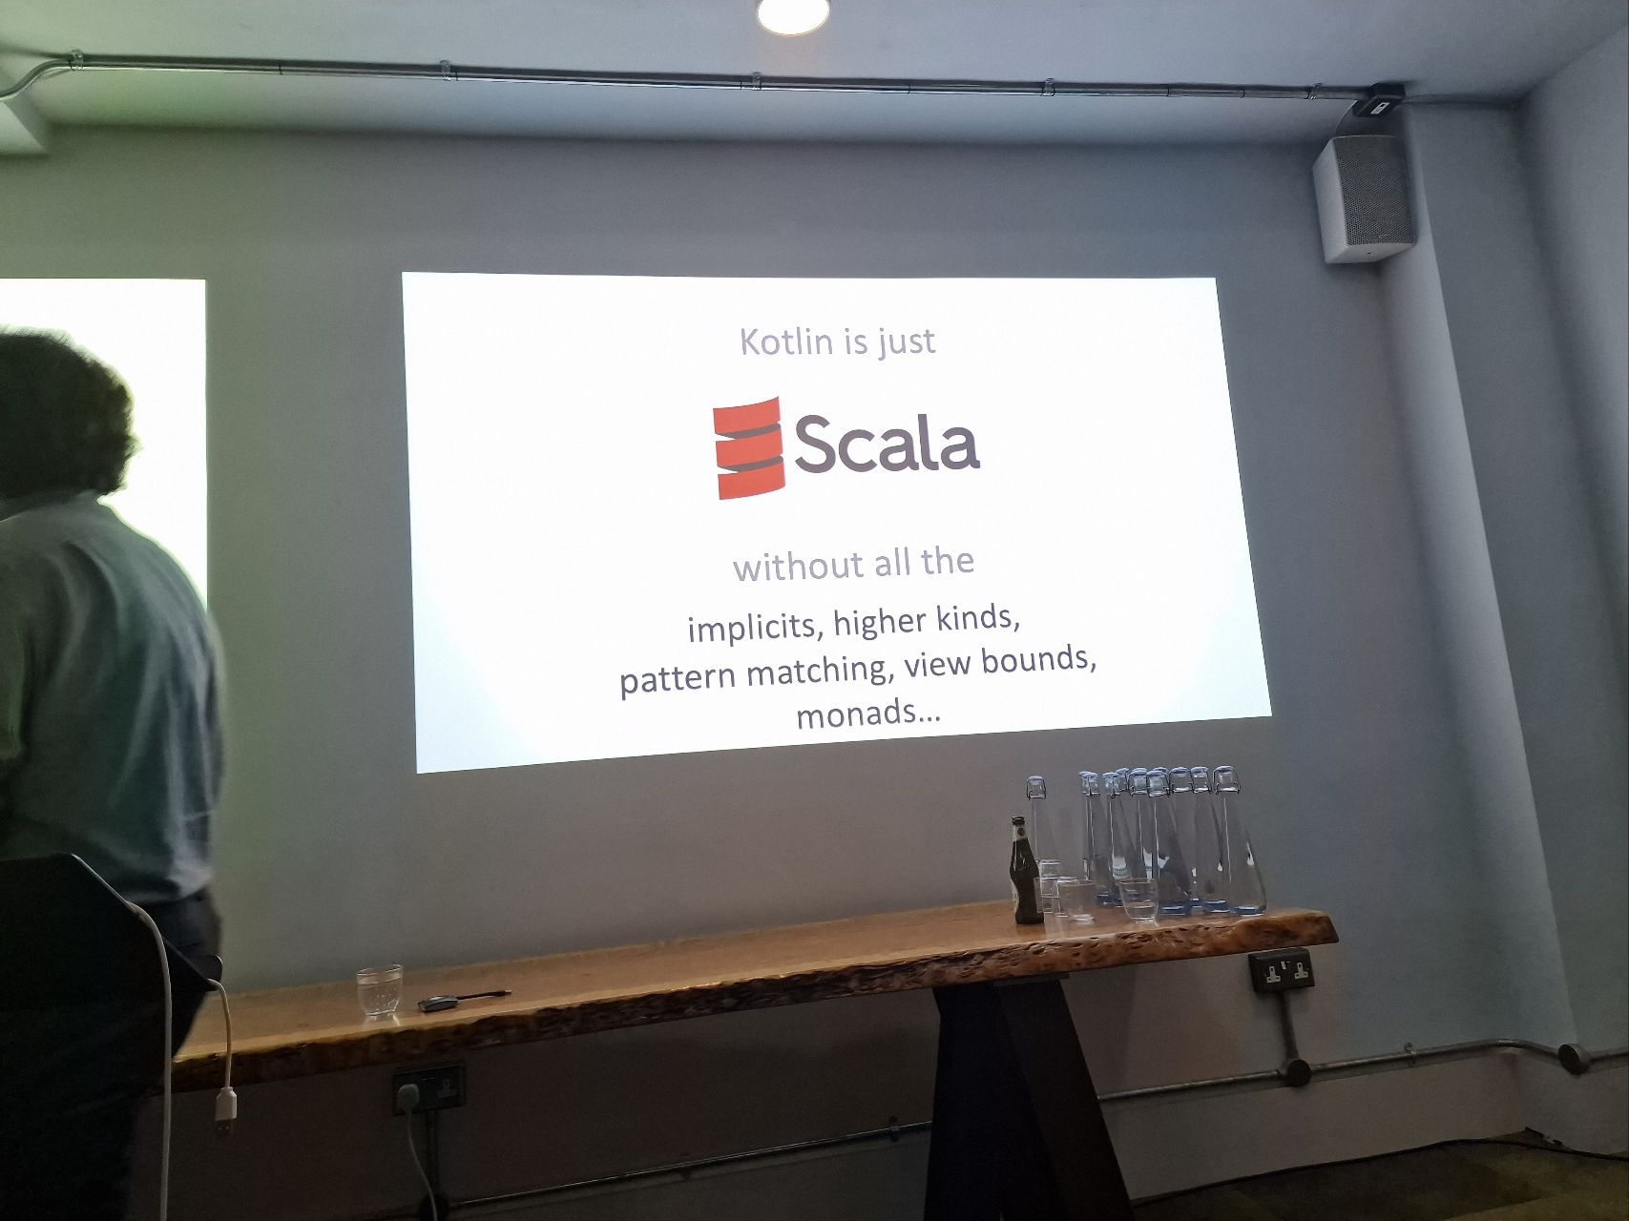
KOTLIN is…
Fist and foremost a pragmatic language
Great tooling
Gaining popularity in the industry
Not restricted to Android
Source Talks: On Kotlin #5 with Andrey Breslav – Shoulders of giants

Slide 7
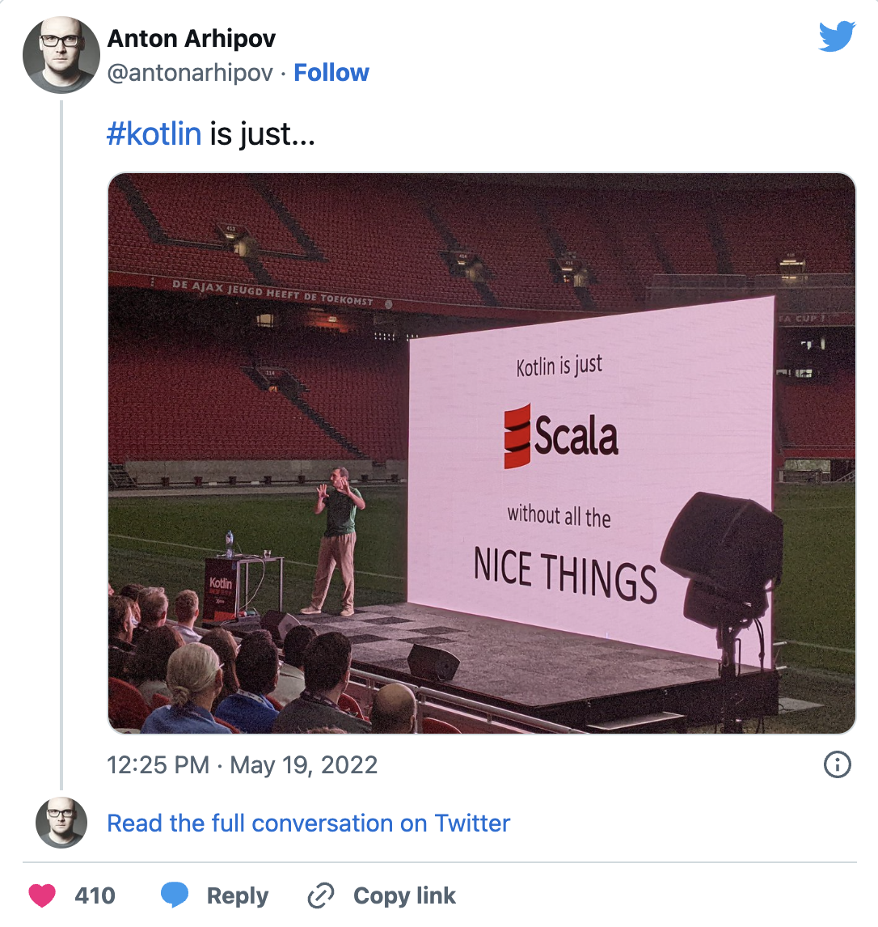
Scala 3 is…
Powerful
Faster than Scala 2
Simpler than Scala 2
Still finding its place in the industry
https://twitter.com/antonarhipov/status/1527249040244723713

Slide 8


Can a language be too powerful for its own good?
Cleaning up some of Scala's features

Slide 9

SCaLa 2 ASCII ART
val l = List(1, 2, 3, 4, 5, 6, 7, 8, 9, 10)
(0 /: l)(_ + _)
// (╯°□°）╯︵ ┻━┻
A cheap shot at a deprecated feature
But Scala 3 is cleaning up a lot of things.
Syntax, Symbols, arity-0 magic, implicits, macros, existential types and much more.
Common theme: JVM languages are converging

Slide 10

DEMOS: The way to get started is to quit talking and begin doing.
Walt Disney

Slide 11
Hello, World! across languages
Java
Kotlin
Scala
Lots of boilerplate
What’s a class? What’s public? What’s static?
Getting better: JShell, JBang, JEP 445.
Clean top level function
Proper tools for beginners REPL, Scripting & Worksheets
Simple but getting more powerful. E.g., Script dependencies.
Scala 2 still needed some boilerplate.
Proper tooling OOB, but can be a little messy
Ammonite, Scala CLI.
Scala 3: Clean,powerful and typesafe

Slide 12
Enums
Subtitle
Subtitle
Add text, images, art, and videos.
Add transitions, animations, and motion.
Save to One Drive, to get to your presentations from your computer, tablet, or phone.
Add text, images, art, and videos.
Add transitions, animations, and motion.
Add text, images, art, and videos.
Add transitions, animations, and motion.
Save to One Drive, to get to your presentations from your computer, tablet, or phone.
Add text, images, art, and videos.
Add transitions, animations, and motion.

Slide 13
Extension methods
Subtitle
Subtitle
Subtitle
Add text, images, art, and videos.
Add transitions, animations, and motion.
Save to One Drive, to get to your presentations from your computer, tablet, or phone.
Add text, images, art, and videos.
Add transitions, animations, and motion.
Add text, images, art, and videos.
Add transitions, animations, and motion.
Save to One Drive, to get to your presentations from your computer, tablet, or phone.
Add text, images, art, and videos.
Add transitions, animations, and motion.
Add text, images, art, and videos.
Add transitions, animations, and motion.
Save to One Drive, to get to your presentations from your computer, tablet, or phone.
Add text, images, art, and videos.
Add transitions, animations, and motion.

Slide 14
Value Classes
Subtitle
Subtitle
Subtitle
Add text, images, art, and videos.
Add transitions, animations, and motion.
Save to One Drive, to get to your presentations from your computer, tablet, or phone.
Add text, images, art, and videos.
Add transitions, animations, and motion.
Add text, images, art, and videos.
Add transitions, animations, and motion.
Save to One Drive, to get to your presentations from your computer, tablet, or phone.
Add text, images, art, and videos.
Add transitions, animations, and motion.
Add text, images, art, and videos.
Add transitions, animations, and motion.
Save to One Drive, to get to your presentations from your computer, tablet, or phone.
Add text, images, art, and videos.
Add transitions, animations, and motion.

Slide 15
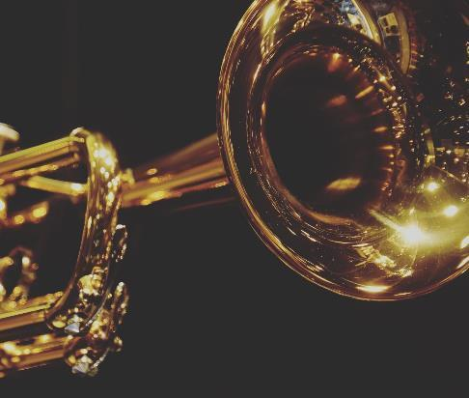
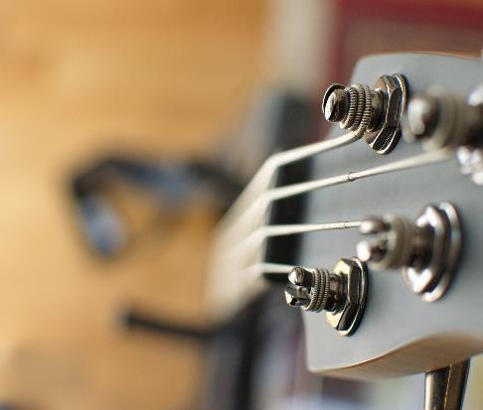
KOTLIN & SCALA 3
Some of the best features of Java, Kotlin & Scala 3 are converging
By design Scala is the more powerful language
Kotlin is a cool language with some nice features of its own OOB (E.g., Null safety, Continuations / Coroutines)
It’s relatively easy to transition from Scala to Kotlin
Choice is a good thing

Slide 16







Questions?
https://www.linkedin.com/in/aaccioly
@anthony@mastodon.accioly.dev
https://stackoverflow.com/users/664577
https://accioly.dev
a.accioly at protonmail.com
Mambo No. 5: A Little Bit of Kotlin in My Life, A Little Bit of Scala 3 in My Mind © 2023 by Anthony Accioly is licensed under CC BY-SA 4.0
https://github.com/aaccioly-demos/mambo-no5

